Slide 1
DocuSync
Team Begoonex

Slide 2
SLOW
ERROR-PRONE
COSTLY
NOT SCALABLE
01
PROBLEM
Manual sorting of delivery notes

Slide 3



Slide 4
TECHNOLOGY OVERVIEW
MARS
JUPITER
VENUS
SATURN
Despite being red, Mars is actually a cold place full of iron oxide dust
Jupiter is a gas giant and the biggest planet in the entire Solar System
Venus has a beautiful name and is the second planet from the Sun
Saturn is a gas giant, composed mostly of hydrogen and helium

Slide 5
THEM
US
USP
Mercury is the closest planet to the Sun and the smallest one in the Solar System—it’s only a bit larger than the Moon
Venus has a beautiful name and is the second planet from the Sun. It’s hot and has a poisonous atmosphere

Slide 6

THANKS!

Slide 7
BUSINESS MODEL
SATURN
EARTH
JUPITER
VENUS
MARS
MERCURY
Saturn is not the only planet with rings
Earth is the only planet known to harbor life
Jupiter is the biggest planet of them all
Venus is the second planet from the Sun
Despite being red, Mars is actually a cold place
Mercury is the smallest planet of them all

Slide 8
TIMING
WEEK 01
WEEK 02
WEEK 03
WEEK 04
MARS
VENUS
SATURN
JUPITER
Despite being red, Mars is cold
Venus has a beautiful name
Saturn is a gas giant with rings
Jupiter is the biggest planet

Slide 9
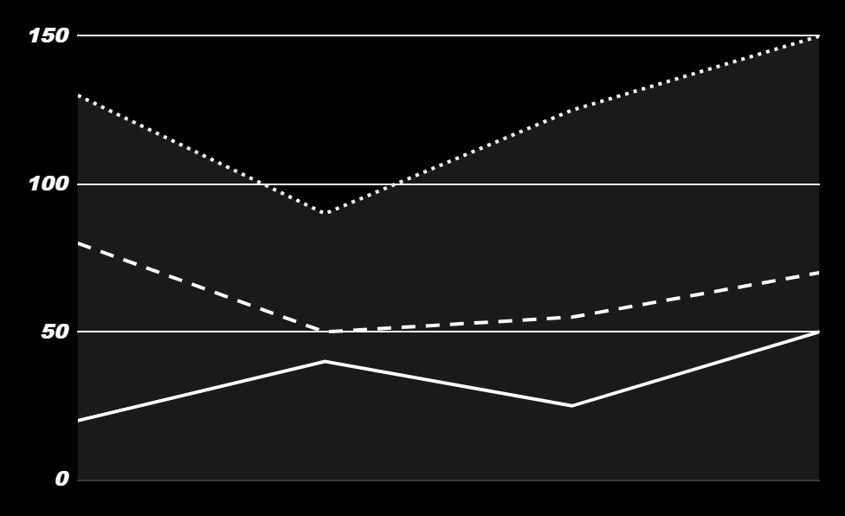
PREDICTED GROWTH
VENUS
100%
Venus is the second planet from the Sun
MARS
55%
Mars is full of iron oxide dust
EARTH
50%
Earth is the third planet from the Sun
20XX
20XX
20XX
Follow the link in the graph to modify its data and then paste the new one here. For more info, click here

Slide 10
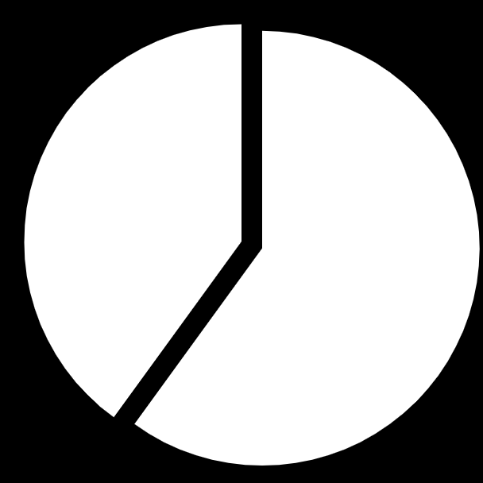
INVESTMENT
40%
60%
EARTH
MARS
Earth is the beautiful planet where we all live
Despite being red, Mars is actually a cold place
Follow the link in the graph to modify its data and then paste the new one here. For more info, click here

